Slide 1

Hospital Patient Queue Management System
CSA0311- Data Structures
GUIDED BY:
Dr.K.Kiruthika
PRESENTED BY:
Mokshitha Kilari(192525413)
Tharlika. K(192572077)

Slide 2


Abstract
Existing hospital queue systems often lead to long waiting times, manual errors, and inefficient patient management. Many automated systems are costly and require complex infrastructure. The proposed Hospital Patient Queue Management System uses the FIFO Queue data structure to register patients, generate tokens, and manage queues efficiently. It provides a simple, fair, and cost-effective solution that improves patient flow, reduces waiting time, and enhances hospital service quality.

Slide 3
Literature Review
S.No | Title of the Paper | Publisher & Published Year | Components / Techniques Used | Disadvantages
1 | Smart Hospital Queue Management | IEEE, 2024 | Queue Scheduling | High implementation cost and requires regular maintenance.
2 | Digital Patient Registration System | Springer, 2023 | FIFO Queue, Database | Depends on database connectivity and has limited scalability.
3 | Hospital Queue Optimization Using Data Structures | Elsevier, 2022 | Queue (FIFO), Linked List | Performance decreases with a large number of patients.
4 | Automated Healthcare Queue Management System | IEEE, 2021 | Patient Registration, Token Generation, Queue Management | Requires trained staff and reliable system infrastructure.

Slide 4
Problem Statement
Existing hospital queue management systems face several limitations, including high implementation costs, dependence on database connectivity, limited scalability, reduced performance during peak hours, and the need for trained staff. These issues increase patient waiting time, reduce operational efficiency, and make queue management difficult.
A simple and efficient Hospital Patient Queue Management System using the FIFO Queue is proposed to improve patient flow and reduce waiting time.

Slide 5
Objectives
Develop a computerized queue management application.
Register patients quickly.
Assign automatic token numbers.
Maintain patient order using FIFO.
Display and serve patients efficiently.
Improve hospital service quality.

Slide 6
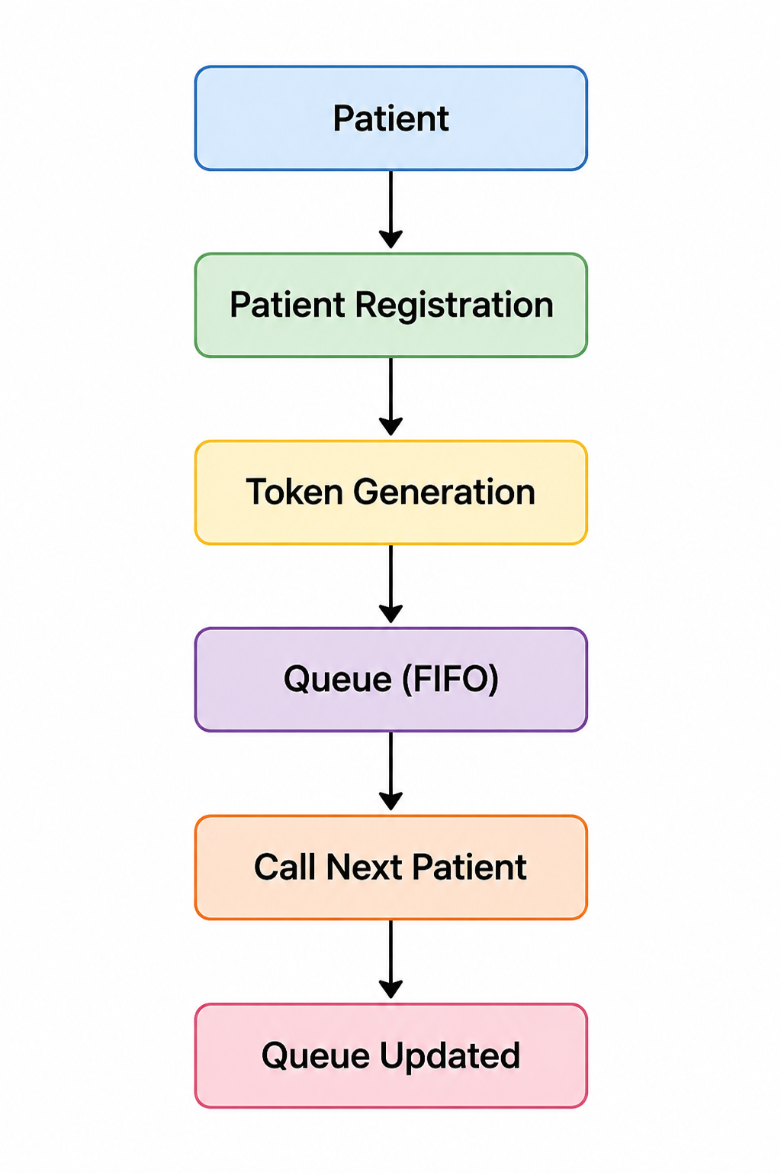
System Architecture

Slide 7
Methodology
Register patient details.
Generate a unique token.
Insert patient into the queue.
Display waiting patients.
Call the first patient.
Remove the served patient.
Continue until the queue becomes empty.

Slide 8
Module 1: Patient Registration
Purpose
Collect patient information and add them to the queue.
Features
Enter patient name
Enter age and gender
Generate token automatically
Save patient information
Add patient to FIFO queue
Data Structure
Queue (FIFO)

Slide 9
Module 2 – Queue Processing
Purpose
Manage patient flow in the correct order.
Features
View current queue
Call next patient
Remove served patient
Update queue automatically
Display remaining patients
Data Structure
Queue using Array / Linked List

Slide 10
Advantages
Reduces patient waiting time.
Ensures fair service using the FIFO principle.
Eliminates manual queue management errors.
Improves hospital workflow and efficiency.
Automatically generates unique token numbers.
Easy to implement and maintain.
Disadvantages
Cannot prioritize emergency patients in a basic FIFO system.
Queue operations stop if the system fails.
Limited functionality without database integration.
Requires staff training for system usage.
Performance may decrease during very high patient traffic.
Needs future upgrades for online appointments and notifications.

Slide 11
Future Scope
Online appointment booking
SMS notification for patients
Doctor availability tracking
Cloud database integration
Mobile application support
AI-based waiting time prediction

Slide 12
Conclusion
FIFO provides fair patient service.
Automation minimizes manual errors.
Token generation simplifies patient handling.
Queue operations improve hospital efficiency.
The system can be enhanced with online appointments and cloud database support.

Slide 13
THANK YOU

